Slide 1



Rating Evaluation Methods through Correlation
presented by Lena Marg,
Language Tools Team
@ MTE 2014, Workshop on Automatic and Manual Metrics for Operational Translation Evaluation
The 9th edition of the Language Resources and Evaluation Conference, Reykjavik

Slide 2





Slide 3
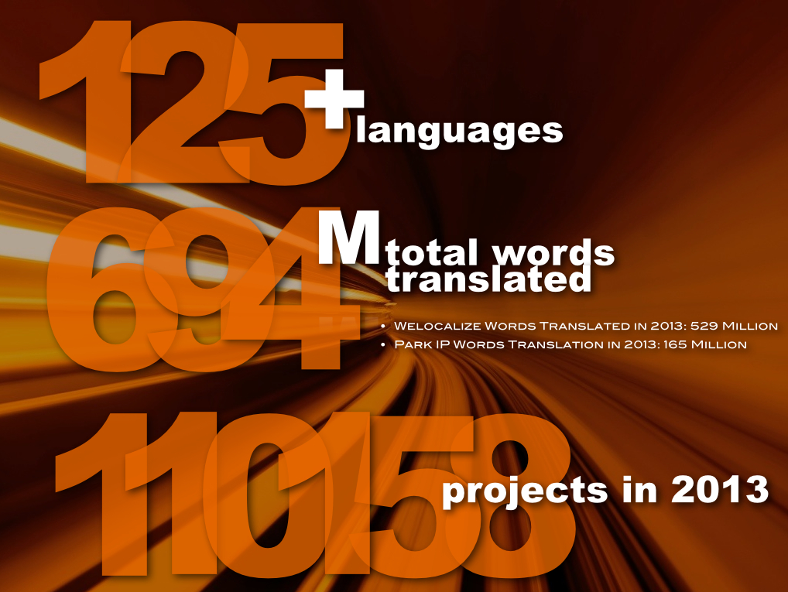

Slide 4


Background on MT Programs @
MT programs vary with regard to:
Scope
Locales
Maturity
System Setup & Ownership
MT Solution used
Key Objective of using MT
Final Quality Requirements
Source Content

Slide 5
MT Quality Evaluation @
1. Automatic Scores
Provided by the MT system (typically BLEU)
Provided by our internal scoring tool (range of metrics)
2. Human Evaluation
Adequacy, scores 1-5
Fluency, scores 1-5
3. Productivity Tests
Post-Editing versus Human Translation in iOmegaT

Slide 6
The Database
Objective:
Establish correlations between these 3 evaluation approaches to
draw conclusions on predicting productivity gains
see how & when to use the different metrics best
Contents:
Data from 2013
Metrics (BLEU & PE Distance, Adequacy & Fluency, Productivity deltas)
Various locales, MT systems, content types
MT error analysis
Post-editing quality scores

Slide 7
Method
Pearson’s r
If r =
+.70 or higher Very strong positive relationship
+.40 to +.69 Strong positive relationship
+.30 to +.39 Moderate positive relationship
+.20 to +.29 Weak positive relationship
+.01 to +.19 No or negligible relationship
-.01 to -.19 No or negligible relationship
-.20 to -.29 Weak negative relationship
-.30 to -.39 Moderate negative relationship
-.40 to -.69 Strong negative relationship
-.70 or higher Very strong negative relationship

Slide 8
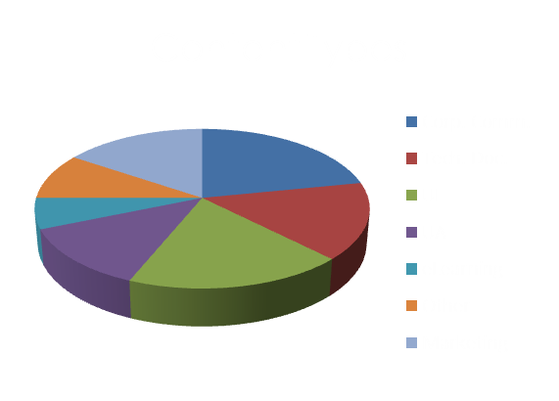

thedatabase
Data Used
27 locales in total, with varying amounts of available data
+ 5 different MT systems
(SMT & Hybrid)

Slide 9
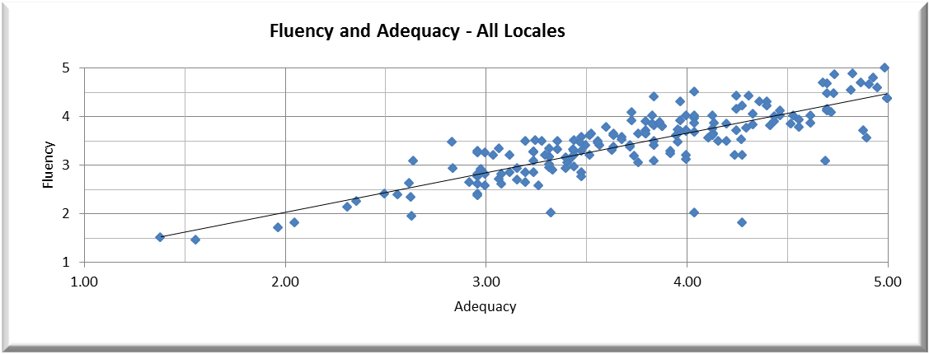
correlationresults
Adequacy vs Fluency
A Pearson’s r of 0.82 across 182 test sets and 22 locales is a very strong,
positive relationship
COMMENT
most locales show a strong correlation between their Fluency and Adequacy scores
high correlation is expected (with in-domain data customized MT systems) in that, if a segment is really not understandable, it is neither accurate nor fluent. If a segment is almost perfect, both would score very high
some evaluators might not differentiate enough between Adequacy & Fluency, falsely creating a higher correlation

Slide 10
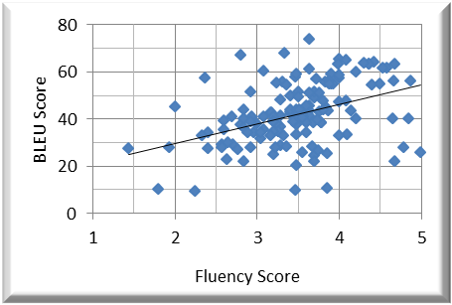
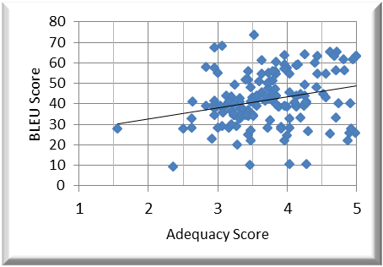
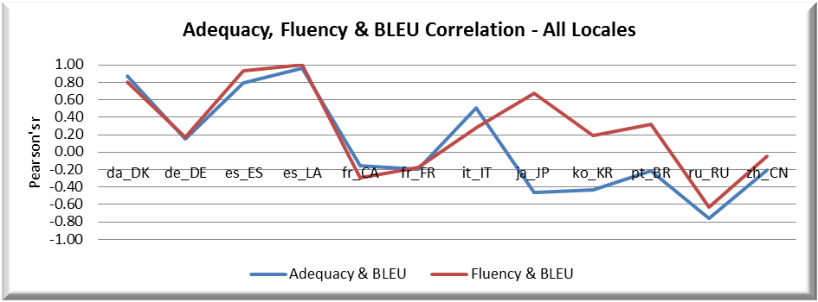
correlationresults
Adequacy and Fluency versus BLEU
Fluency and BLEU across locales have a Pearson’s r of 0.41, a strong positive relationship
Adequacy and BLEU across locales have a Pearson’s r of 0.26, a moderately positive relationship
Adequacy, Fluency and BLEU correlation for locales with 4 or more test sets*
Notes:
NOTE: correlations found for individual languages with 4 or more sets, but not enough data to be statistically relevant.
But it does show that BLEU isn‘t a good indicator
* Also points out that HE needs to be done accurately

Slide 11
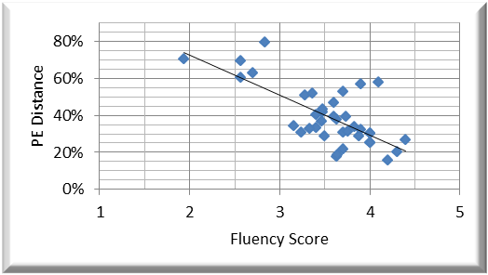
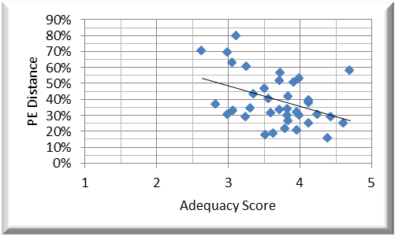
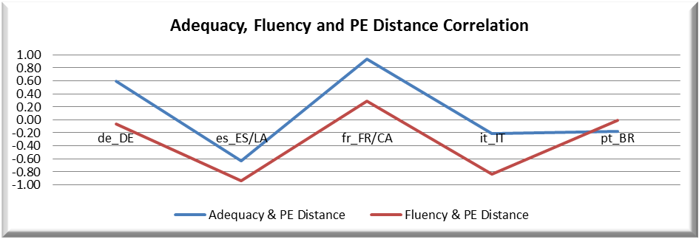
correlationresults
Adequacy and Fluency versus PE Distance
Fluency and PE distance across all locales have a cumulative Pearson’s r of -0.70, a very strong negative relationship
Adequacy and PE distance across all locales have a cumulative Pearson’s r of -0.41, a strong negative relationship
A negative correlation is desired: as Adequacy and Fluency scores increase, PE distance should decrease proportionally.

Slide 12
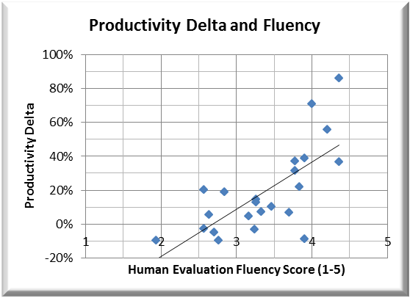
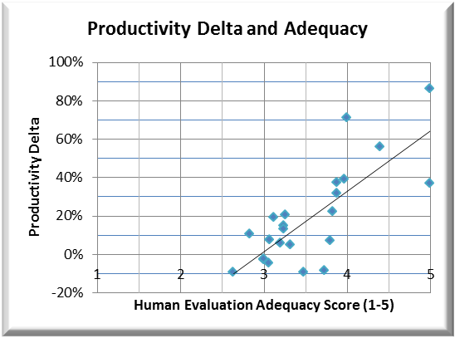
correlationresults
Adequacy and Fluency versus Productivity Delta
Productivity and Fluency across all locales with a cumulative Pearson’s r of 0.71, a very strong correlation
Productivity and Adequacy across all locales with a cumulative Pearson’s r of 0.77, a very strong correlation

Slide 13
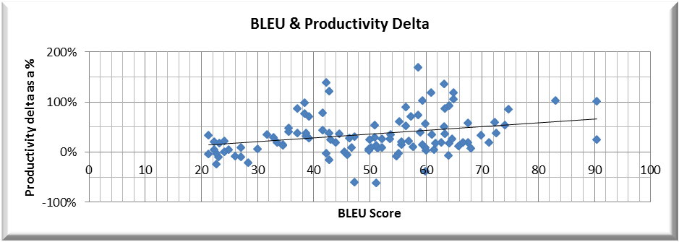
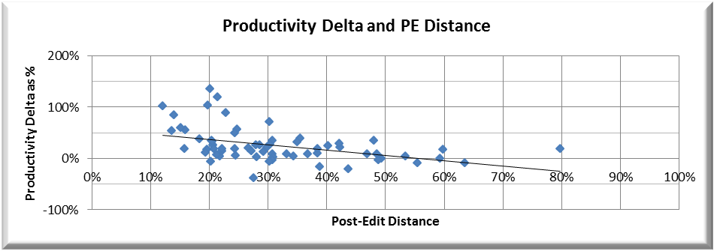
correlationresults
Automatic Metrics versus Productivity Delta
Productivity delta and BLEU with a cumulative Pearson’s r of 0.24, a weak positive relationship
With a Pearson’s r of -0.436, as PE distance increases, indicating a greater effort from the post-editor, Productivity declines; it is a strong negative relationship

Slide 14
correlationresults
Summary
Pearson's r | Variables | Strength of Correlation | Tests (N) | Locales | Statistical Significance (p value <)
0.82 | Adequacy & Fluency | Very strong positive relationship | 182 | 22 | 0.0001
0.77 | Adequacy & P Delta | Very strong positive relationship | 23 | 9 | 0.0001
0.71 | Fluency & P Delta | Very strong positive relationship | 23 | 9 | 0.00015
0.55 | Cognitive Effort Rank & PE Distance | Strong positive relationship | 16 | 10 | 0.027
0.41 | Fluency & BLEU | Strong positive relationship | 146 | 22 | 0.0001
0.26 | Adequacy & BLEU | Weak positive relationship | 146 | 22 | 0.0015
0.24 | BLEU & P Delta | Weak positive relationship | 106 | 26 | 0.012
0.13 | Numbers of Errors & PE Distance | No or negligible relationship | 16 | 10 | ns
-0.30 | Predominant Error & BLEU | Moderate negative relationship | 63 | 13 | 0.017
-0.32 | Cognitive Effort Rank & PE Delta | Moderate negative relationship | 20 | 10 | ns
-0.41 | Numbers of Errors & BLEU | Strong negative relationship | 63 | 20 | 0.00085
-0.41 | Adequacy & PE Distance | Strong negative relationship | 38 | 13 | 0.011
-0.42 | PE Distance & P Delta | Strong negative relationship | 72 | 27 | 0.00024
-0.70 | Fluency & PE Distance | Very strong negative relationship | 38 | 13 | 0.0001
-0.81 | BLEU & PE Distance | Very strong negative relationship | 75 | 27 | 0.0001

Slide 15


takeaways
CORRELATIONS
The strongest correlations were found between:
Adequacy & Fluency
BLEU and PE Distance
Adequacy & Productivity Delta
Fluency & Productivity Delta
Fluency & PE Distance
The Human Evaluations come out as stronger indicators for potential post-editing productivity gains than Automatic metrics.

Slide 16
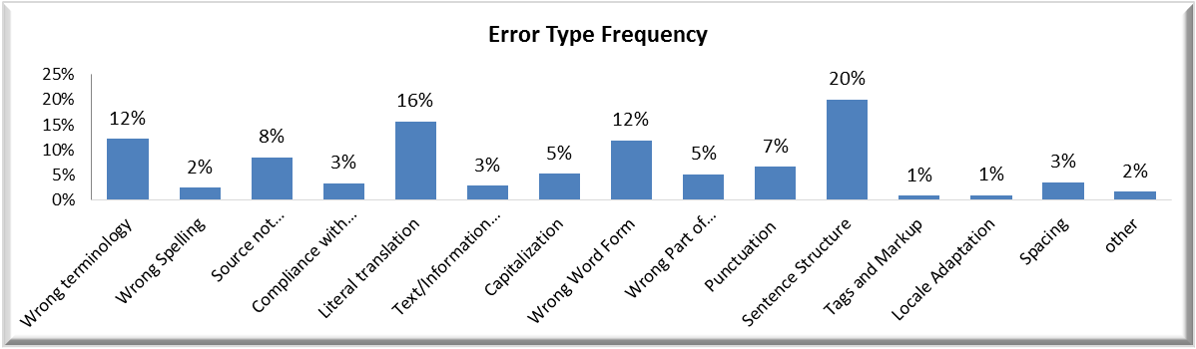
erroranalysis
Data size: 117 evaluations x 25 segments (3125 segments), includes 22 locales, different MT systems (hybrid & SMT).
Taking this “broad sweep“ view, most errors logged by evaluators across all categories are:
Sentence structure (word order)
MT output too literal
Wrong terminology
Word form disagreements
Source term left untranslated

Slide 17
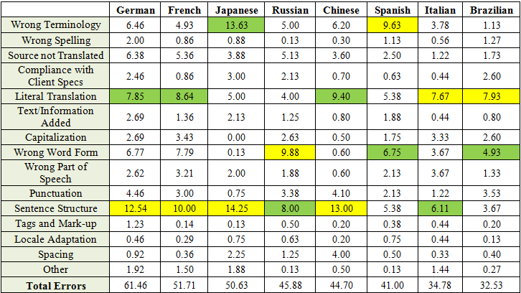
erroranalysis
Similar picture when we focus on the 8 dominant language pairs that constituted the bulk of the evaluations in the dataset.

Slide 18
takeaways
MOST FREQUENT ERRORS LOGGED
Across different MT systems, content types AND locales, 5 error categories stand out in particular.
Questions:
How (if) do these correlate to the post-editing effort and predicting productivity gains?
How (if) can the findings on errors be used to improve the underlying systems?
Are the current error categories what we need?
Can the categories be improved for evaluators?
Will these categories work for other post-editing scenarios (e.g. light PE)?

Slide 19
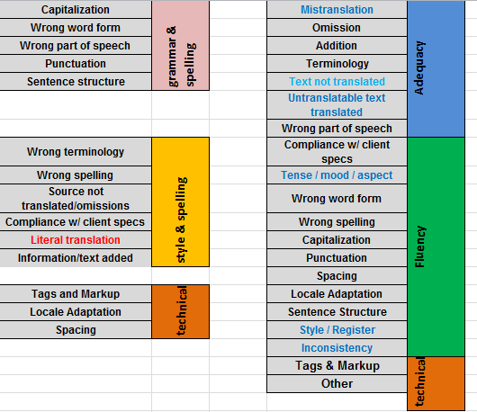
takeaways
Remodelling of Human Evaluation Form to:
increase user-friendliness
distinguish better between Ad & Fl errors
align with cognitive effort categories proposed in literature
improve relevance for system updates
E.g.“Literal Translation“ seemed too broad and probably over-used.

Slide 20
nextsteps
focus on language groups and individual languages: do we see the same correlations?
focus on different MT systems
add categories to database (e.g. string length, post-editor experience)
add new data to database and repeat correlations
continuously tweak Human Evaluation template and process, as it proofs to provide valuable insights for predictions, as well as post-editor on-boarding / education and MT system improvement
investigate correlation with other AutoScores (…)

Slide 21
THANK YOU!
lena.marg@welocalize.com
with Laura Casanellas Luri, Elaine O’Curran, Andy Mallett

